Slide 1

Our Everyday Problem
Wearing something new over and over again and getting completely bored of it
Go on a Shopping spree and come home with a black hole in your pocket for things that you will only wear a few times
Work a 9-5 and want a power makeover to your wardrobe but end up shopping for fun non-work clothes, every time!
Hate the mall, laundry, cheap clothes and want to slash your shopping expenses but still want to wear that amazing dress for a big event.
Need the better fit of designer clothes and know you really are probably too old to keep shopping at some of the stores.
Are you contemplating life while looking at your closet, seeing where all your money went and still got nothing to wear?

Slide 2

Challenge
Designer Clothes That Look As Beautiful On You As They Do Online
The Selection is Really Endless
Expensive!!

Slide 3




Rental ReStyle
Look Like a Million Bucks But Aren’t Going Broke

Slide 4

Our Solution
Make designer clothes affordable
Delivery at your doorstep
Deliver high street design, at pocket friendly prices
Have all kind of trendy clothes
You Look Like a Million Bucks But Aren’t Going Broke

Slide 5
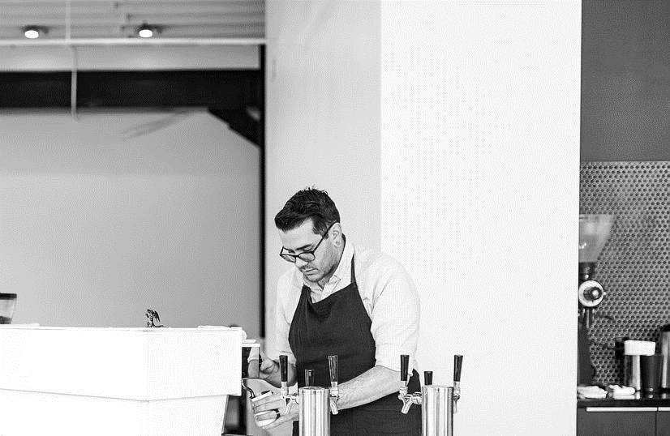
Business Value
Reduced Cost
Flexibility
Provide high quality services affordable
Shorter Time Length
Diversity
Creation and Expansion of market share

Slide 6
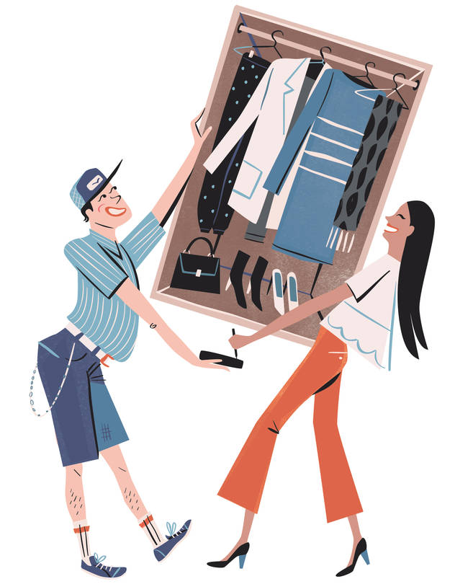
Users
Customer : performs search and rents clothes from application.
Designer : Adds new clothes to the application.
Delivery Unit :Takes care of inventory details and delivery of rented clothes.
Customer Representative : Interacts with customer and provides assistance.
System Representative : Verifies the designer , customer details and payment information.

Slide 7
Use Cases
Customer
Sign up for application
Add item to the cart
Checkout
Payment
Place the order
Request for return
Feedback
Contact customer representative
Designer
Customer Representative
System Representative
Delivery
Sign up for the application
Check notifications for orders
Update the delivery status
Sign up for the application
Check notifications for orders
Update the delivery status
Verify the designer
Verify for payment
Check Order status
Interact with customers
Provide appropriate assistance

Slide 8

Business Metrics
Fashion Trend
Time Utilization
Rental Rate according to area
Potential Rental Days
Sales Trend

Slide 9
THANK YOU

